Slide 1







Team-29
DevRev Problem Statement

Slide 2



Abstract
Our final pipeline is a three-step approach to solve the retrieval and question-answering task. We majorly used transformers to form the embeddings and extract the answers. The pipeline consists of the Retriever Module, Re-Ranker Module and the Reader Module. These along with some clever optimisations helped us achieve great scores.

Slide 3


Literature Review
Unsupervised Document Embedding via Contrastive Augmentation by Luo et al. [1]
Adaptive Margin Diversity Regularizer for handling Data Imbalance in Zero-Shot SBIR by Dutta et al. [2]
Towards Universal Paraphrastic Sentence Embeddings by Wieting et al. [3]
SimCSE: Simple Contrastive Learning of Sentence Embeddings by Gao et al. [4]

Slide 4
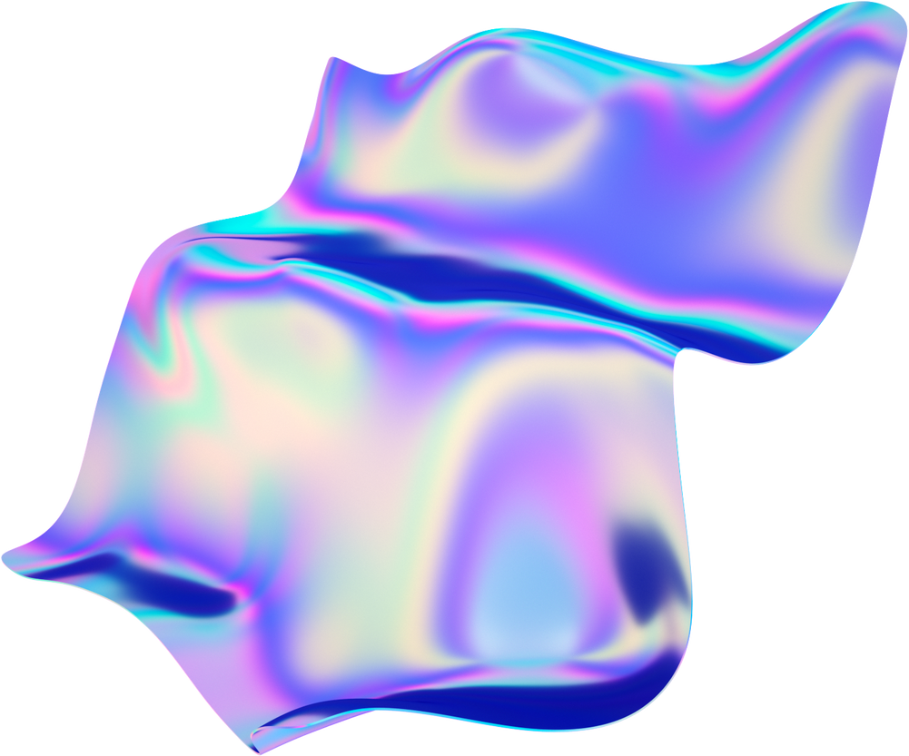
Implementation Roadmap
Paragraph Retrieval
Re-Ranking Module
Reader Module
Context/Query encoder
Similarity Metric
Experiment with Retriever:
A)Classification with Adaptive Margin Regularisation
B) Contrastive Learning
New and different cross encoder models
Extraction of best answer text from retrieved passages

Slide 5
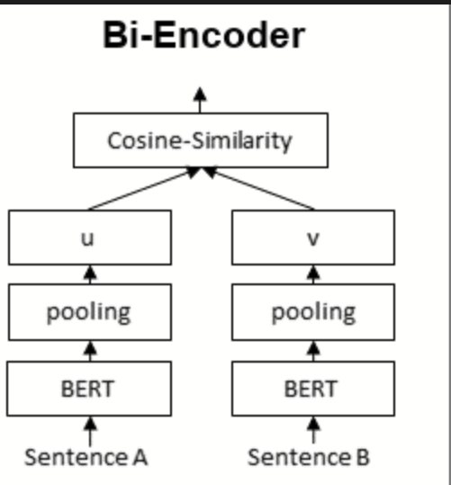
Paragraph Retrieval
Context/Query Encoder:
We experimented with various models and methods for encoding, like
Word2Vec Averaging,
FastText,
Wiki2Vec
Doc2Vec
Transformer-based models, including
Sentence BERT,
Google Universal Sentence Embeddings
a ROBERTA-based model

Slide 6
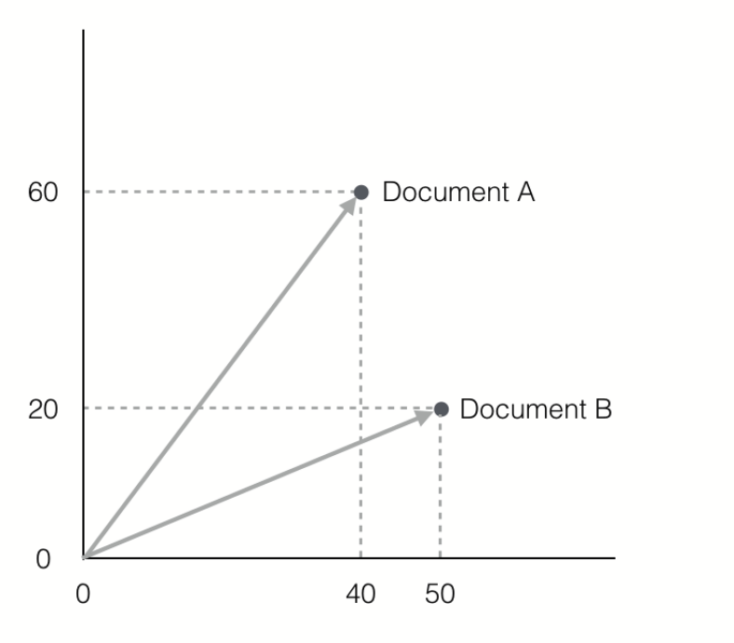
Paragraph Retrieval
Similarity Metric
We used cosine similarity as our similarity metric and found that it performed better than the slower euclidean distance.
The query and context encoder representations were stored in a vector database
We selected the top-K most similar contexts for each query and passed them to the re-ranking model.

Slide 7


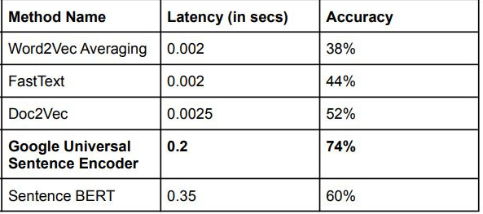
Research on Query encoder models
Google Universal Sentence Encoder
FastText
Sentence Bert
Word2Vec
Doc2Vec

Slide 8


Experiments With Retriever
We also conducted several experiments to improve the embeddings generated by the encoder. The two main approaches were:
Contrastive Learning:
Cluster embeddings by fixing context embeddings as anchor points
Contrastive Loss brings relevant question embeddings closer in the latent space.
Classification with Adaptive Margin Regularization:
Bring the context embeddings and query embeddings in the same latent space
Added a loss which increases the margin between two context points.
Both approaches have potential for improving retriever accuracy and would benefit from more data and time.

Slide 9
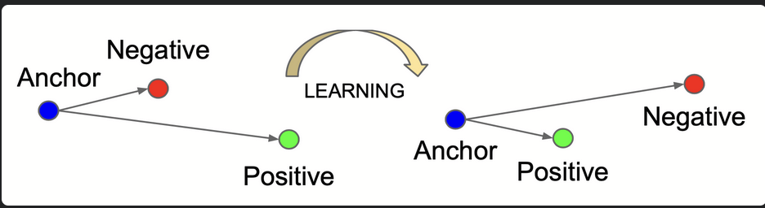
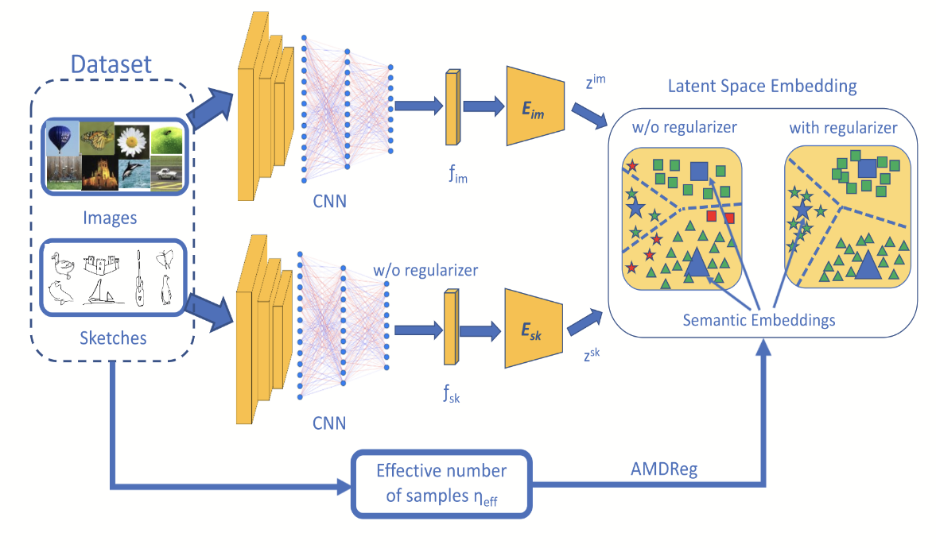
Visualisation of the
Contrastive Loss
Diagram of how the AMDReg Works.
(Diagram taken from the cited paper [2])

Slide 10
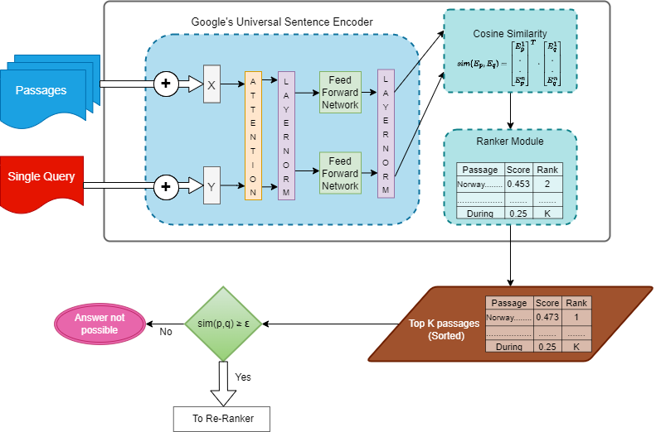
Retrieval Pipeline

Slide 11


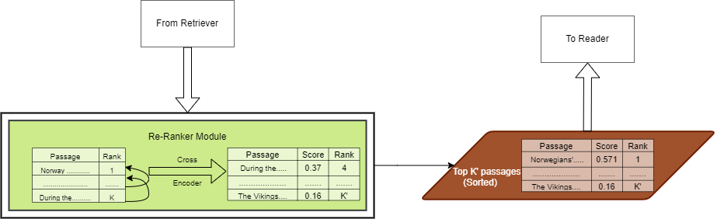
Re-Ranking Module
To improve the performance of the vanilla retriever model, we introduced a cross-encoder model that re-ranks retrieved contexts and questions based on their answerability. This significantly improved the performance metric. We tried three cross encoders (MiniLM, Roberta Tiny, and Tiny BERT) and Tiny BERT proved to be the fastest and most efficient, given the hardware constraints.
 | Evaluation Metric
Score Without Re-Ranker | 0.65
Score with Ranker | 0.74
Re-Ranker Module

Slide 12
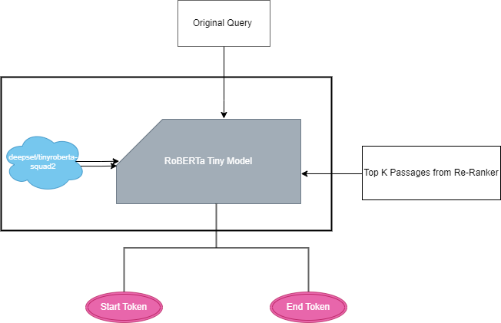
Reader Module
The final step in the pipeline was to use a model for extracting answers from the retrieved and re-ranked passages. We used the same model from our mid-evaluation as it had the best results, being both fast and having the best metric.
Reader Module

Slide 13
Optimisations
Choice of Language Models Used
Pre-Computing The Context Embeddings
Parallelising on the CPU
The use of Ray Library increased performance by allowing parallel processing of the model on multiple CPU cores
Google Colab's free tier offers 2 CPU cores, which only reduced our inference time by half.
Our inference script can scale to multiple CPU cores for even faster processing.
Light weight models like MiniLM, Tiny BERT, and RoBERTa Tiny
The best model was selected by evaluating them on a 25% split of the training data.
The context embeddings were pre-computed and stored in a vector database.
Only new question embeddings were calculated during inference.

Slide 14
Other Experiments and Ablation Studies
Generative Pseudo Labelling and Data Augmentation:
We tried two methods to address the issue of unanswerable questions and insufficient questions in some themes
Pseudo Question Creation.This took too long (1.5 hours for 10 questions) and was not feasible for the entire dataset.
Data augmentation techniques like sentence reordering, synonym replacement, random swaps, and random deletions.
Method | Train Time | Final Score
Pseudo Label Generation | 9 minutes per question | N/A
Data Augmentation | 0.462 seconds | 0.63
Specific Reader Models | 20 mins for 1 epoch | 0.53
Making Theme Specific Models :
Fine-tuning the RoBERTa Tiny reader model on each theme was tried to make it specialized in answering questions from a particular theme,
However, this resulted in overfitting to the training data and a drop in score to 0.53. The generalization of pre-trained models on the SQuAD v2 dataset proved to be more effective.

Slide 15
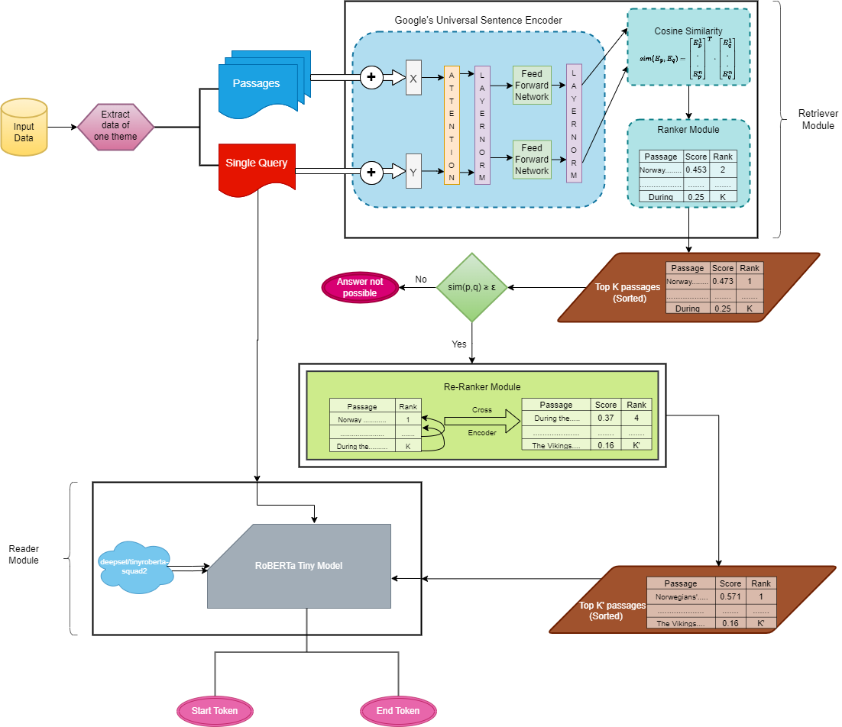
Final Pipeline

Slide 16
Final Result and Conclusions
Our pipeline achieved a 0.74 score for paragraph retrieval and 0.71 for question-answering, an improvement over the mid-eval results. Lack of data and inability to use external data hindered further improvements through better hyperparameter tuning.

Slide 17
Future Work
There are a few possible ways to further improve the quality of the retrieved documents. We list a few here:
Averaged Query Expansion:
Use the top-k retrieved document and average their embeddings
Forms a query from within the distribution of the contexts.
Re-retrieve the top-k passages using this query
Increase per context query size.
Work on improving document embeddings i.e. use the increased dataset to train models which use methods like AMDReg

Slide 18
Questions?

Slide 19
Thank You

